Slide 1
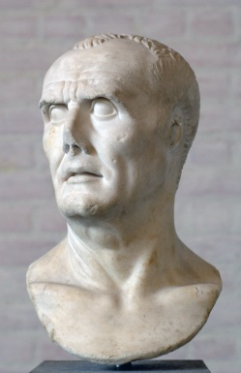
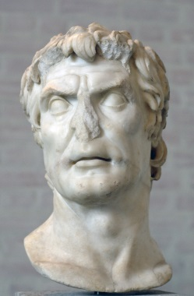
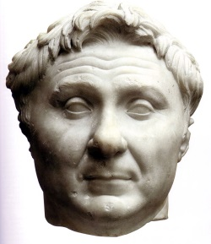
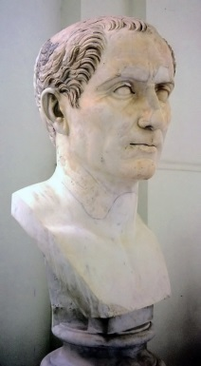
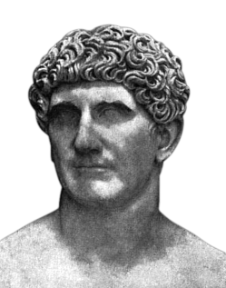
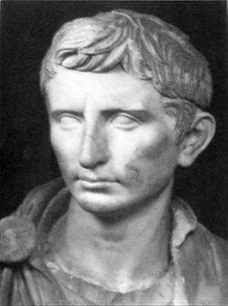
Civil Wars
Marius
Sulla
Pompey
Julius Caesar
Mark Antony
Octavian

Slide 2
Roman Political Factions
Optimates
Populares
Sing. optimatis
Supporters of senatorial power
Usually members of the patrician class
E.g. Sulla
Sing. popularis
Supporters of reforms favoring plebeian interests
Included many aristocrats and senators, as well as novi homines
E.g. the Gracchi, Marius

Slide 3
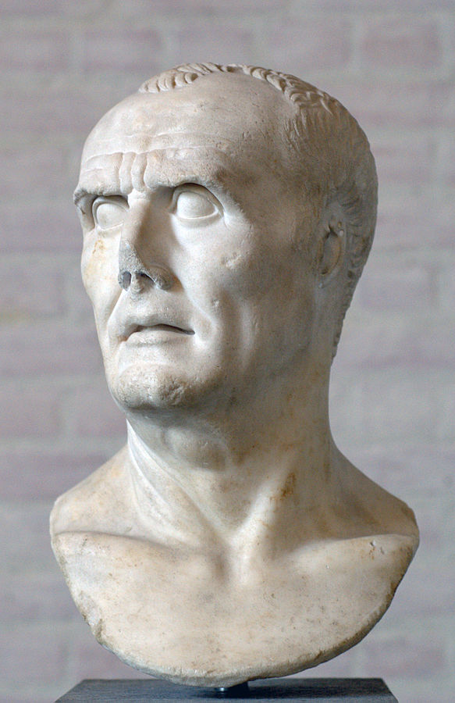
Gaius Marius
c. 157-87 BCE
Served in the siege of Numantia in Spain in 134-3 and in the Balearic Islands in 124
Quaestor in Transalpine Gaul in 122
Tribune of the Plebs in 119
Praetor of Further Spain in 115

Slide 4
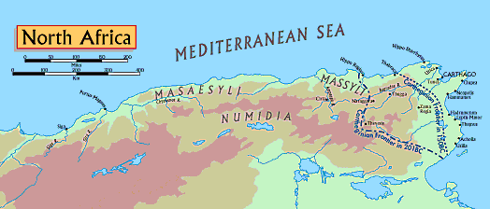
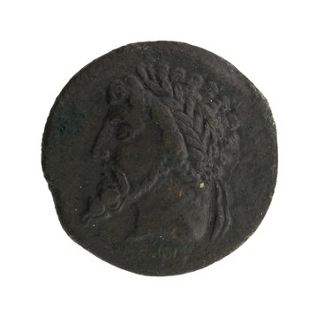
Numidia
Masinissa, king of Numidia from 201 to 148 BCE

Slide 5
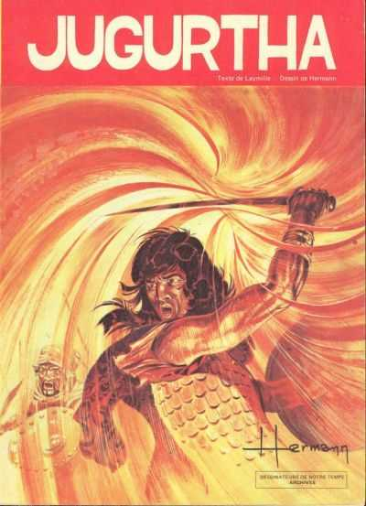
Jugurtha
c. 160-104 BCE
Grandson of Masinissa, adopted by Micipsa, king of Numidia (148-118)
Micipisa left Numidia to his sons Adherbal and Hiempsal, and to Jugurtha
Jugurtha killed Hiempsal and defeated Adherbal
Romans partitioned Numidia, but Jugurtha captured Cirta and executed Adherbal and any Romans who supported him

Slide 6
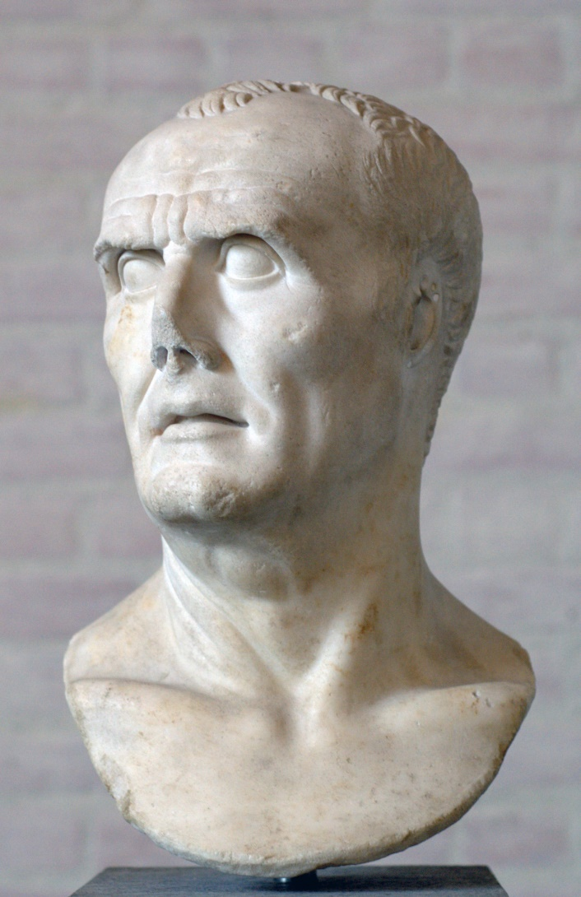
The Jugurthine War
Rome sends Quintus Caecilius Metellus to Numidia
Who brings Marius as a legate
When Metellus cannot defeat Jugurtha, Marius returns to Rome to run for consul in 107
Prosecutes the war with renewed vigor after his election, capturing Jugurtha in 105

Slide 7
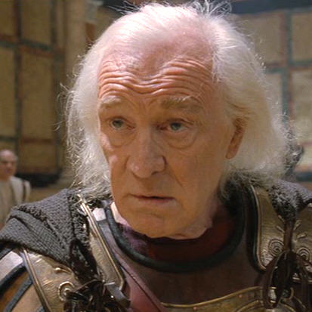
But…

Slide 8

Lucius Cornelius Sulla
138-78 BCE
Member of a patrician family
Quaestor in 107
Served in the Jugurthine War under Marius
Persuaded King Bocchus of Mauretania to betray his son-in-law Jugurtha

Slide 9
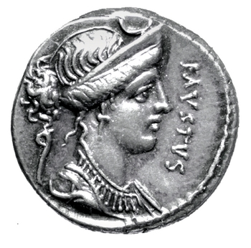
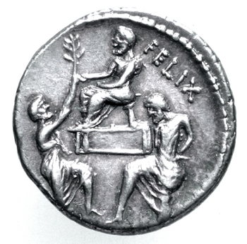
Lucius Cornelius Sulla
*
Silver denarius, Rome, Italy, c. 56 BCE; obv.: diademed head of Diana r.; legend: FAVSTVS (Sulla’s son); rev.: Sulla seated l., Bocchus kneeling r. holding olive branch, Jugurtha kneeling l. with hands tied behind his back; legend: FELIX (Sulla’s nickname)

Slide 10
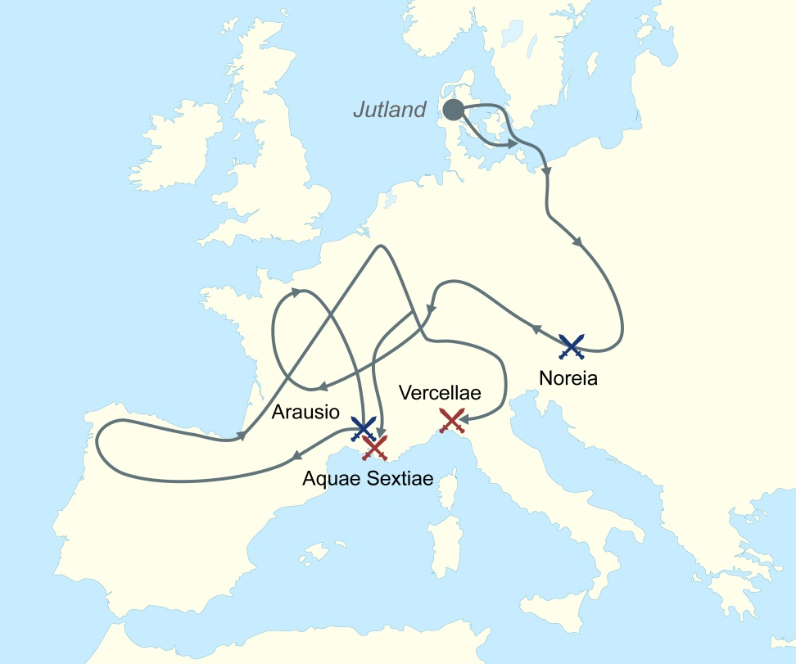
Cimbri and Teutones
Tribes from Jutland (modern Denmark) who migrated into southern Europe
Invaded Noricum and threatened the Taurisci, who asked Rome for help
Roman army was defeated at Noreia in 112
Next invaded Gaul and defeated the Romans again at Aurasio in 105

Slide 11
Marius to the Rescue
Fresh from his victory against Jugurtha, Marius was reelected consul in 104
But since the Cimbri and Teutones didn’t attack right away, Marius spent years recruiting an army of poorer Roman citizens and drilling them like gladiators
Reelected consul every year between 104 and 100
Finally defeated the Cimbri and Teutones at Aquae Sextiae in Gaul in 102 and then at Vercellae in the Po River valley in 101

Slide 12
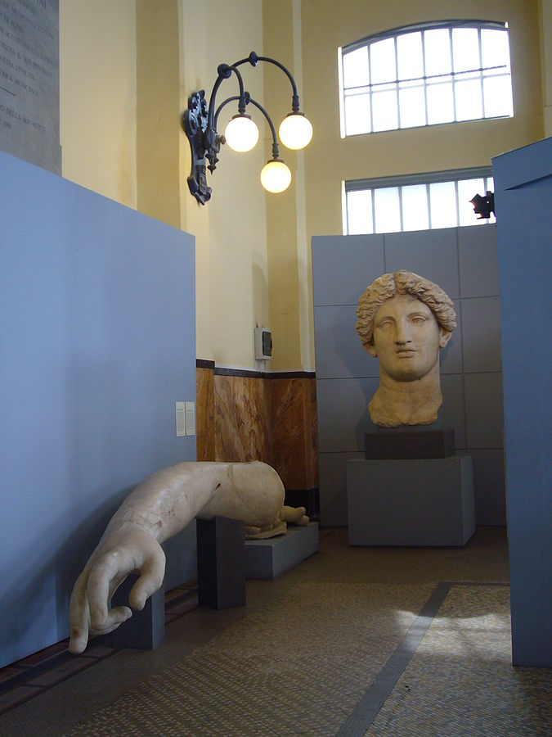
Fortuna Huiusce Diei
“Fortune of This Day”
Vowed by Q. Lutatius Catulus, Marius’ co-consul, at Vercellae in 101 BCE in Cisalpine Gaul
Temple B at Largo Argentina in Rome
Arm and head of a colossal statue of Fortunta, c. 1st cen. BCE

Slide 13
Marius in Charge
Tried to secure land and grain for his veterans
Joined forces with the tribune Appuleius Saturninus
In the process Saturninus murdered a rival candidate for office
A riot broke out, and Marius permitted the optimates to kill Saturninus

Slide 14
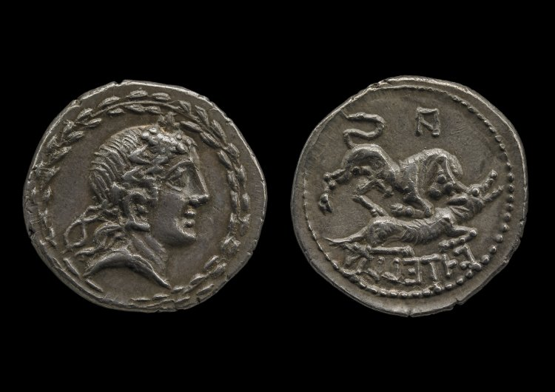
Social War (c. 91-88 bce)
From Latin socii = ‘allies’
The tribune Marcus Livius Drusus attempted to obtain Roman citizenship for the Italians
Assiassinated in 91
Italians revolted against the Romans and set up a capital at Corfinium
Romans had numerical superiority, and offered citizenship to any Italian city that surrendered
Marius and Sulla both held field commands during the war; Sulla was even elected consul for 88 BCE
In 89 the consul Pompeius Strabo granted Roman citizenship to all communities south of the River Po
*
Silver coin of the Italian allies, c. 90-89 BCE; obv.: head of Bacchus; rev.: bull attacking a wolf; inscription (in Oscan): ITALIA

Slide 15
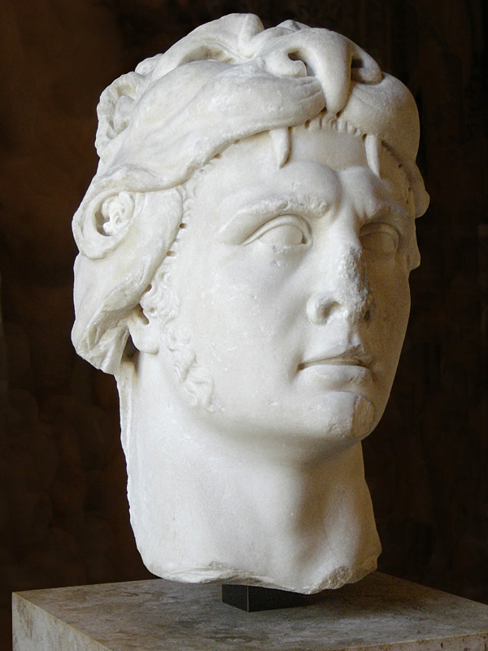
Mithradates
Mithradates VI, king of Pontus 120-63 BCE
Supposedly took poison as a child to built up his tolerance

Slide 16
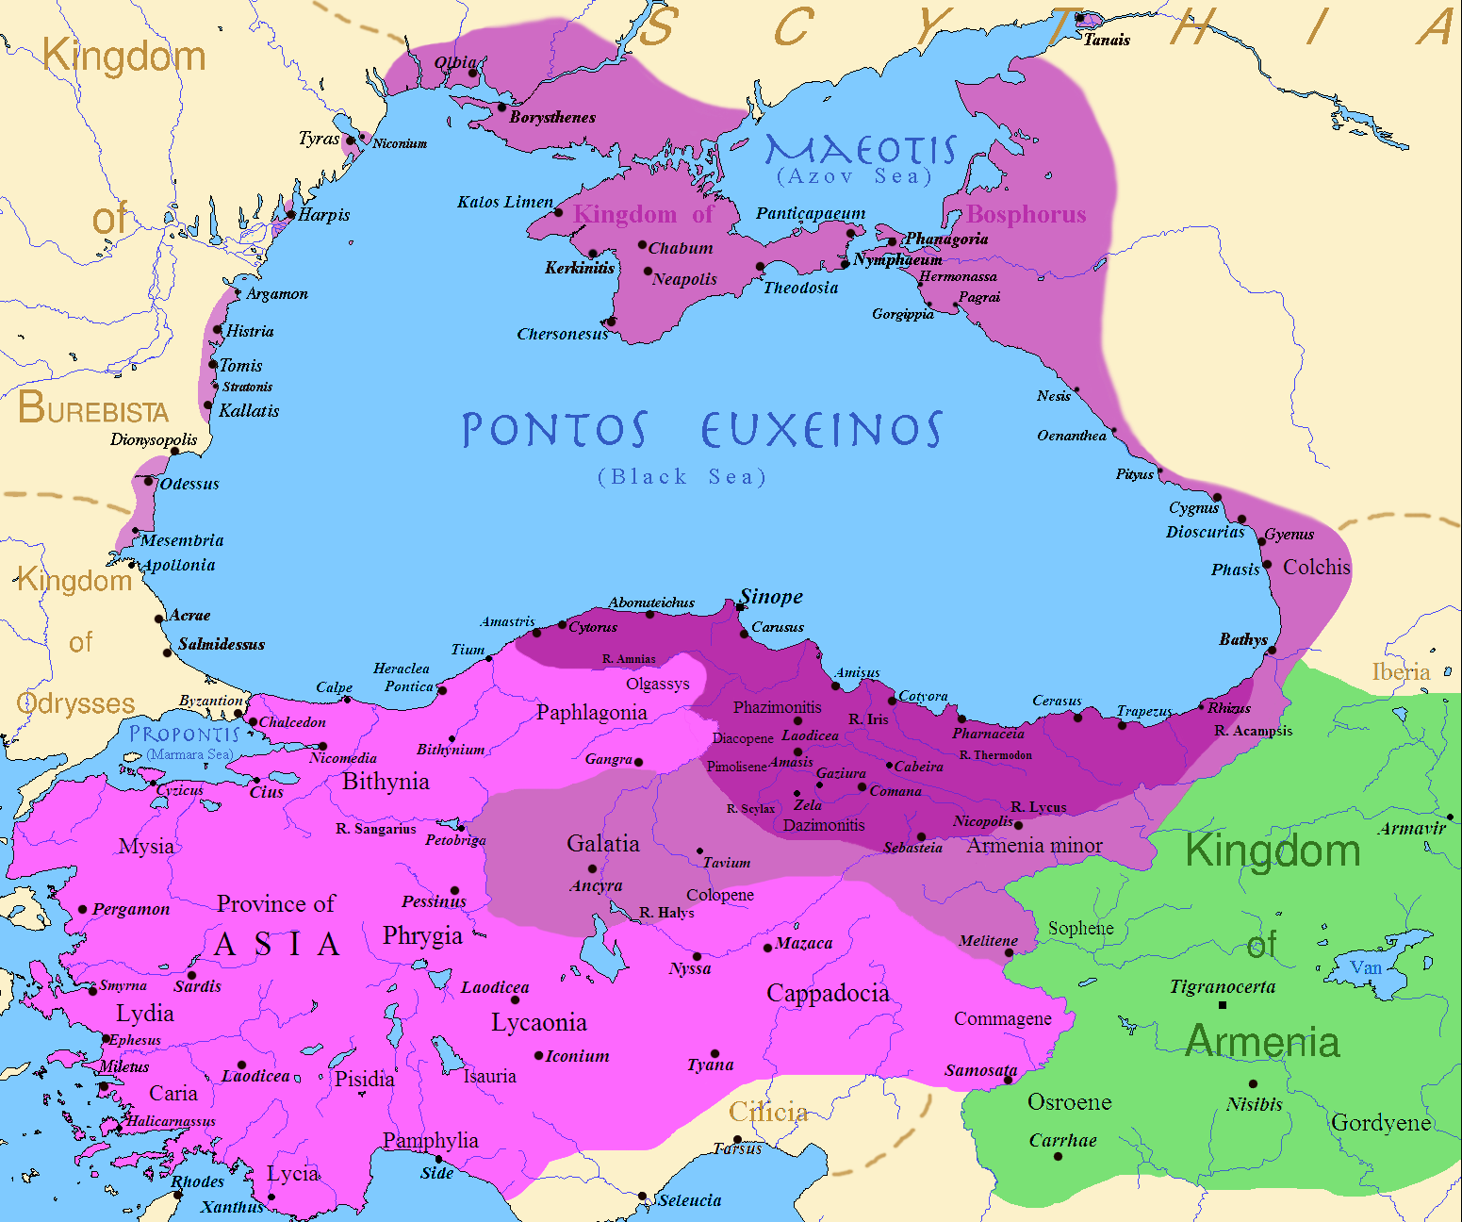
Mithradates
Pontus
Bithynia
Paphlagonia
Cappadocia
Roman province of Asia

Slide 17
Marius vs. Sulla

Slide 18
Marius vs. Sulla
Sulla given command of the war against Mithradates
Marius allied with a tribune and the tax farmers to assign himself the command
Sulla rallied his army in Campania and marched on Rome
Marius and his allies were banished; Sulla’s command was restored

Slide 19
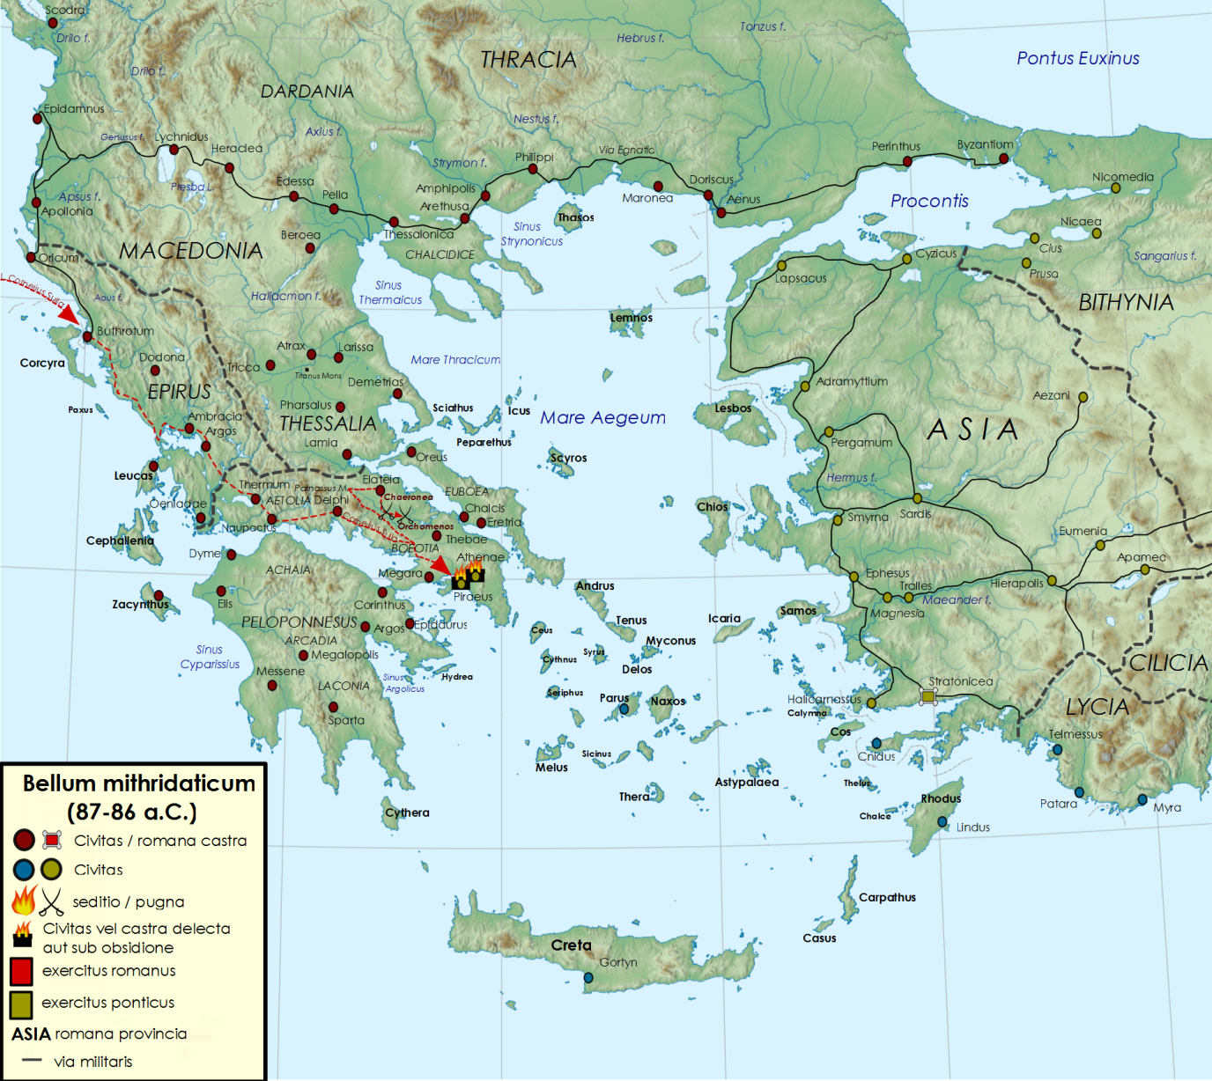
Sulla vs. Mithradates
Mithradates invades Cappadocia and Asia
Mainland cities join Mithradates; Pontic army enters Greece
Romans under Sulla arrive
Athens besieged in 87
Roman victories at Charonea and Orchomenos in 86
Mithradates surrenders to Sulla, NOT to his successor, in 85

Slide 20
Marius’ Coup
While Sulla was in Greece, the consul L. Cornelius Cinna proposed to reorganize the voting blocs
Opposed by his co-consul Octavius
Cinna recalled Marius from exile; Marius raised an army of freed slaves and marched on Rome
Marius and Cinna became consuls and began murdering their opponents
Many people fled to Sulla’s army in Greece
Marius died in 87 BCE, just after taking office
Cinna suspended the constitution and was the primary ruler of Rome until 84

Slide 21
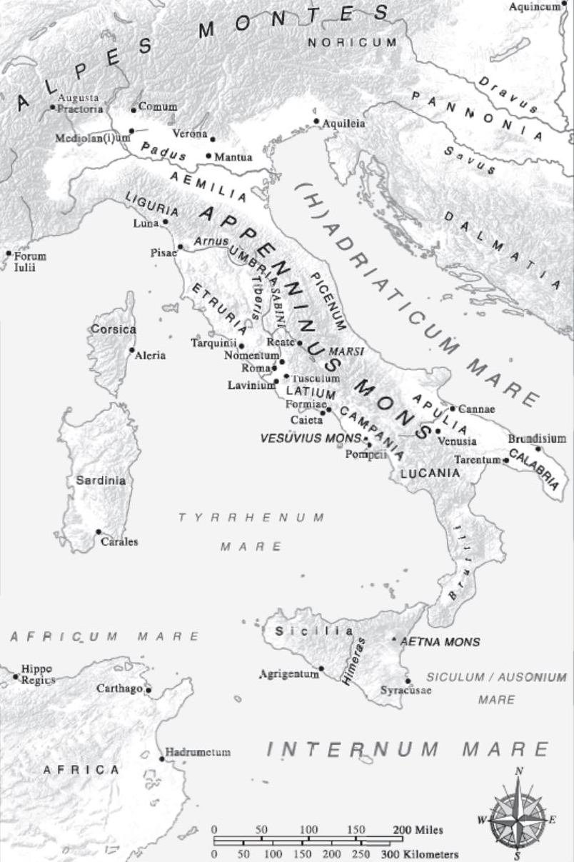
Sulla’s Return
Landed his army at Brundisium in 83 BCE
Defeated the consul Gaius Norbanus in Campania
Besieged the forces of Gaius Marius, Jr., at Praeneste, near Rome
Populares began killing optimates in Rome
Sulla defeats the last of the populares outside the Colline Gate of Rome in 82

Slide 22
Sulla the Dictator
Appointed dictator in 82 BCE
Posted ‘proscription’ lists of political opponents, who could be murdered with impunity and whose property was sold at low prices
The optimates acquired most of this property
Such as Crassus, the future triumvir
Lists overseen and manipulated by Sulla’s freedman Chrysogonus

Slide 23
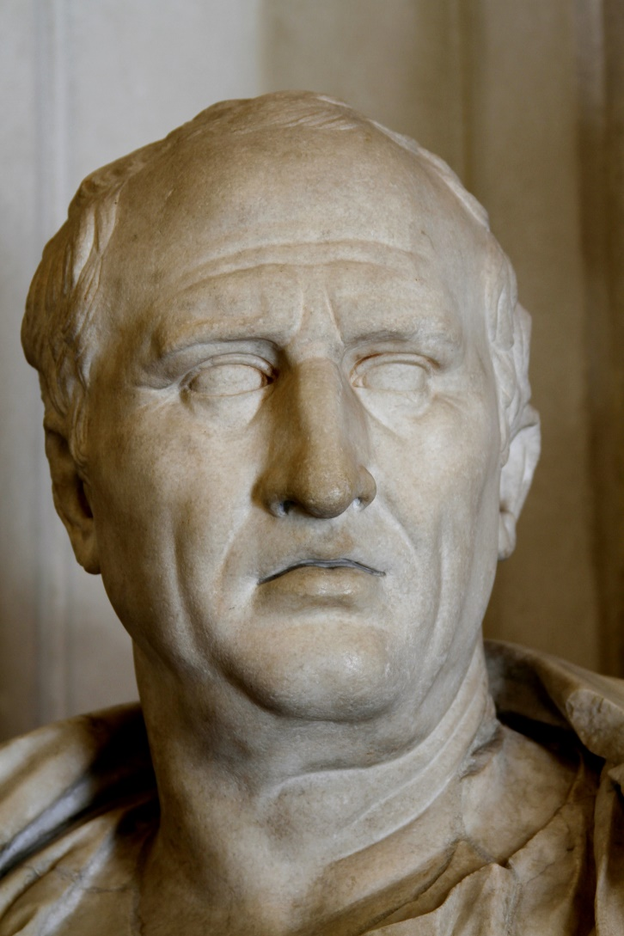
The Case of Sextus Roscius
Father murdered by his own relatives
Relatives conspired with Chrysogonus to acquire the victim’s land
So Chrysogonus put Roscius’ name on the proscription list
Roscius hid out with Caecilia Metella, so his would-be murders charged him with patricide
Cicero defended him in court

Slide 24
The Case of Sextus Roscius
*
“Since his father, a man of such distinction and popularity, had been killed without any difficulty, it would be very easy to get rid of the son, unsuspicious as he was, living in the country, and unknown in Rome. The Roscii promised their assistance for this purpose…
“The name of Sextus Roscius, a zealous supportor of the nobles, was entered on the proscription list; Chrysogonus became the purchaser. Three farms, perhaps the best known, were handed over to Capito as his own property, and he is in possession of them this very day. As for the rest of the property, this Titus Roscius, as he himself says, seized it in the name of Chrysogonus.”
- Cicero, In Defense of Roscius 20-21 (80 BCE)

Slide 25
Sulla the Dictator (cont.)
Settled his veterans in new colonies in Italy
Increased the Senate to 600 members
Limited the rights of tribunes
Could no longer propose laws without the approval of the Senate
Like Tiberius Gracchus did
Made former tribunes ineligible for other magistracies
Replaced Equestrian judges with Senators
Established a court to punish magistrates who waged war without permission or who brought their armies into Italy
Like he had done himself
Gave himself the agnomen ‘Felix’ = ‘fortunate’

Slide 26
The End of Sulla
Resigned the dictatorship in 81 BCE
Became consul in 80
Retired to Campania in 79
Died in 78

Slide 27
End of Round One
Consuls could be reelected
Soldiers more loyal to their generals than to the republic
Violence was now a standard means for achieving political goals

Slide 28
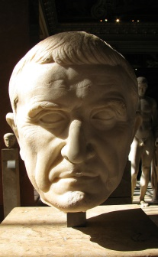
Civil Wars
Got rich off Sulla’s proscriptions
Son-in-law of Cinna, Marius’ ally; lost his post as Pontifex Maximus under Sulla’s regime
Marius
Sulla
Crassus
Pompey
Julius Caesar
Raised an army in support of Sulla
Mark Antony
Octavian

Slide 29
Key Terms
Gaius Marius
Lucius Cornelius Sulla
Optimates
Populares
Jugurtha
Mithradates
Proscription
Chrysogonus

